Slide 1



Noida Institute of Engineering and Technology, Greater Noida
Social Media Marketing
Unit: 2
SOCIAL MEDIA MARKETING
Ms. Preeti Singh
School of Management
B. Tech 6th Semester

Slide 2

Index/Content
S. No. | Index
1. | Name of Subject with code, Course and Subject Teacher
2. | Brief Introduction of Faculty member with Photograph
3. | Evaluation Scheme
4. | Syllabus
5. | Branch wise Application
6. | Course Objective(s)
7. | Course Outcome(s)
8. | Program Outcomes (POs)
9. | COs and POs Mapping

Slide 3
Index/Content
S. No. | Index
10. | Program Specific Outcomes (PSOs)
11. | Cos and PSOs Mapping
12. | Program Educational Objectives (PEOs)
13. | Result Analysis
14. | End Semester Question paper Templates
15. | Prequisite/Recap
16. | Brief Indtroduction about the Subject with Videos
17. | Unit Contents
18. | Unit Objectives
19. | Topic Objectives/Topic Outcome

Slide 4
Index/Content
S. No. | Index
20. | Lecture related to topic
21. | Daily Quiz
22. | Weekly Assignment
23. | Topic Links
24. | MCQs
25. | Glossary Questions
26. | Old question papers
27. | Expected Questions
28. | Recap of unit

Slide 5
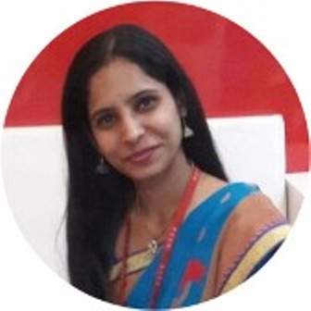
Faculty Profile
Ms. Preeti Singh
Assistant Professor
Department: Management Studies
Email ID: preeti.singh@niet.co.in
Qualification: BBA, MBA, M.Phil
Specialisation: HRM
Total Teaching Experience: 8+ years
Teaching Area: HR, Marketing, General Management

Slide 6
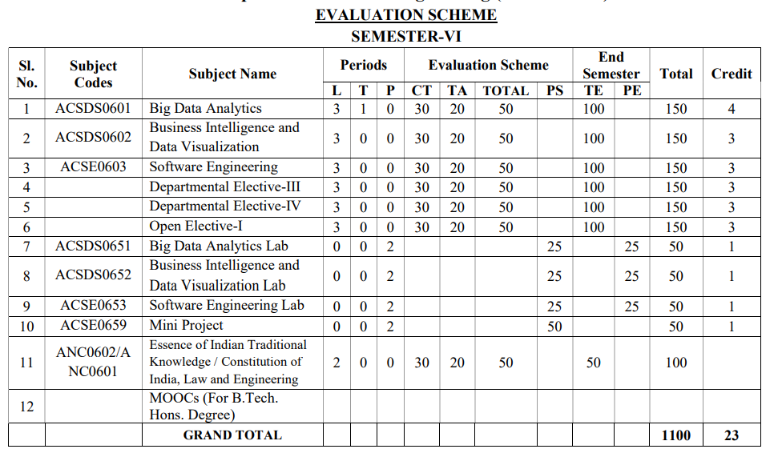
Evaluation scheme

Slide 7

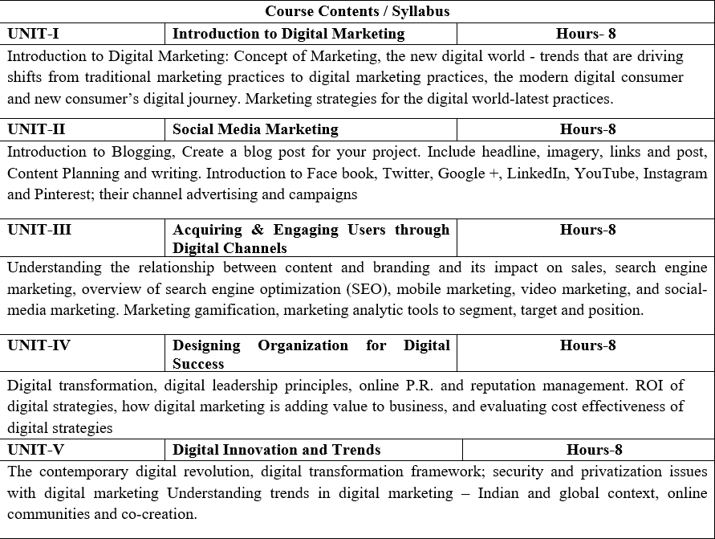
Subject Syllabus

Slide 8
Applications in B.Tech
Not everyone can navigate through fierce competition except those who are not afraid of being ingenious in their approaches. Since this ingenuity comes naturally to engineers, Digital Marketing is a perfect platform to widen their horizons and constantly challenge their critical and creative thinking processes.
Combining social media’s benefits and IT soft skills, digital marketers have revolutionized industrial trade and commerce. The broad base and direct interpersonal reach that digital marketing after Btech establishes with its prospective consumer make it one of the most viable and successful marketing modes.

Slide 9
Course Objectives
Provide understanding of digital and social media marketing practices.
Provide understanding of different social media platforms
Impart learning on various digital channels and how to acquire and engage consumers online.
Provide insights on building organizational competency by way of digital marketing practices and cost considerations.
Develop understanding of the latest digital practices for marketing and promotion.

Slide 10
Program Outcomes (POs)

Slide 11
CO-PO Mapping
S No | CO/PO | PO1 | PO2 | PO3 | PO4 | PO5
1 | CO1
2 | CO2
3 | CO3
4 | CO4
5 | CO5
 | Average
High=3,Medium =2 ,Low=1

Slide 12
Program Specific Objectives
At the end of the program, the student will be able to
Analyse, design and develop solutions by applying fundamental concepts of Data Science.
Apply technical knowledge while using modern tools and technologies for solving complex problems.
Collaborate different fields of science and technology with right attitude, to work as an individual or as a team, and demonstrating professional ethics for the well-being of the society.

Slide 13
Program Educational Objectives
The graduates of the B.Tech Data Science program will:
Solve real-time complex problems and adapt to technological changes with the ability of lifelong learning.
Work as data scientists, entrepreneurs, and bureaucrats for the goodwill of society and pursue higher education.
Exhibit professional ethics and moral values with good leadership qualities and effective interpersonal skills.

Slide 14
Result Analysis

Slide 15
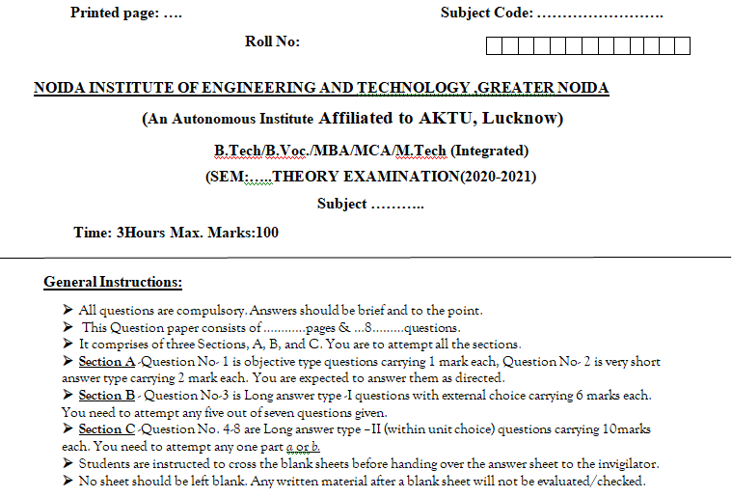
End Semester Question Paper Template

Slide 16
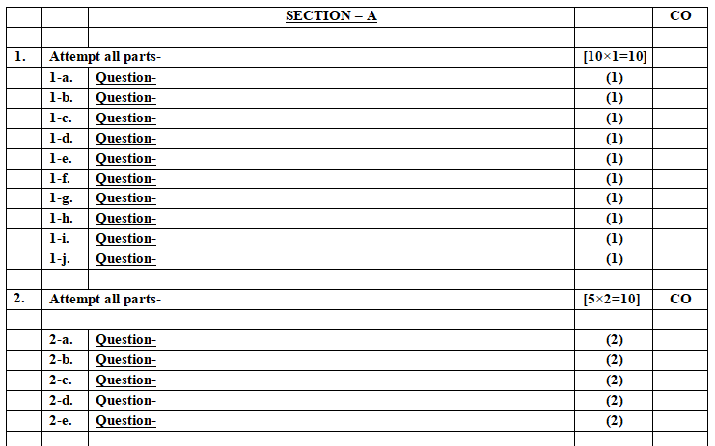
End Semester Question Paper Template

Slide 17
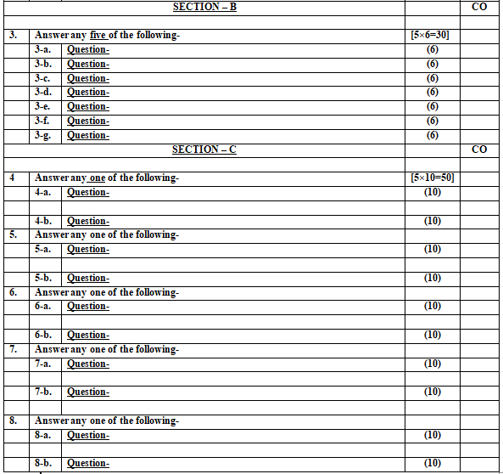
End Semester Question Paper Template

Slide 18
Prerequisite and Recap
Student must have basic understanding of Marketing and Social media.

Slide 19
Introduction of the subject
The course is designed to make learner conversant with Digital Marketing and proficient in Social Media tools and techniques starting from the fundamentals of digital marketing.
Social media websites and applications allow users to create and exchange user-generated content where people talk, share information, participate and network through technologies such as blogs and social networking sites.
Within the last decade, social media has become one of the most powerful sources for news updates, online collaboration, networking, viral marketing and entertainment.
https://www.youtube.com/watch?v=Xuq6_udbeH0&list=PLi3oNa09iwJRByiNwEJNaZ3XVKcveovzk
https://www.youtube.com/watch?v=X-pCbWwu50k

Slide 20
Unit Content
Introduction to blogging: Create a blog for your Project. (CO2)
Include headline, imagery, links and post, Content Planning and writing. (CO2)
Introduction to Face book, Twitter, Google +, LinkedIn, YouTube, Instagram and Pinterest. (CO2)
Their channel advertising and campaigns (CO2)

Slide 21

Noida Institute of Engineering and Technology, Greater Noida
(Unit –II) Topic 1
Introduction to blogging

Slide 22
Objective of Topic /Session
Students will learn about :
Concept of Blogging
How to create a blog post
Headlines & Imagery

Slide 23
Blogging
A blog is a website (maintained by an individual or organization) where people post entries of commentary, or other material such as graphics or video. Entries are commonly displayed in reverse chronological order.
Typically, blogs provide comments or opinions on particular topics or themes.

Slide 24
Blogging(CO2)
Blogging is often described as an online diary or simply as an easy interface to publish content on the web.
Blogs can be used to publish news and reviews and to discuss products and ideas.
Notes:
From the readers’ perspective, a good blog provides useful, free information and helps them to stay informed on the subject of their interest.
The internet contains blogs on almost every issue imaginable – in fact, it is estimated that there are currently over 150 million blogs floating around on the Internet!

Slide 25
Blogging(CO2)
It is easy to set up your own blog. Websites such as www.Wordpress.com and www.Blogger.com all provide you with easy setup services and options for the layout and management of your blog.
You can also create a blog or a page on an online networking site.
You can collect links, provide information and updates to your customers on a regular basis, and provide a means for your customers to interact with you.
Notes:
From the readers’ perspective, a good blog provides useful, free information and helps them to stay informed on the subject of their interest.
The internet contains blogs on almost every issue imaginable – in fact, it is estimated that there are currently over 150 million blogs floating around on the Internet!

Slide 26
Creating a Blog post (CO2)
How to Write a Blog Post in Five Easy Steps
Step 1: Plan your blog post by choosing a topic, creating an outline, conducting research, and checking facts.
Step 2: Craft a headline that is both informative and will capture readers’ attentions.
Step 3: Write your post, either writing a draft in a single session or gradually word on parts of it.

Slide 27
Creating a Blog post (CO2)
Step 4: Use images to enhance your post, improve its flow, add humor, and explain complex topics.
Step 5: Edit your blog post. Make sure to avoid repetition, read your post aloud to check its flow, have someone else read it and provide feedback, keep sentences and paragraphs short, don’t be a perfectionist, don’t be afraid to cut out text or adapt your writing last minute.

Slide 28


Slide 29
Tips for Using Your Own Blog to Promote Your Business
Create a professional-looking blog.
Keep your blog posts positive and to the point.
Create useful content for your target audience. Write about your area of business expertise. Provide updates about your business, and your products and services.
Provide links on your blog to the sales section of your website.
Make content available in RSS feed to permit syndication of your blog material, making the material available to other websites
Notes:
From the readers’ perspective, a good blog provides useful, free information and helps them to stay informed on the subject of their interest.
The internet contains blogs on almost every issue imaginable – in fact, it is estimated that there are currently over 150 million blogs floating around on the Internet!

Slide 30
Tips for Using Your Own Blog to Promote Your Business
Think carefully before posting your entry. Is it respectful? Professional?
Follow sound customer service principles.
If you have your own blog you can write about upcoming business events and sales.
Link to other relevant websites and blogs.
Go to www.technorati.com and claim your blog. This can help ensure that you are indexed in blog search engines.
Track your progress. Review your web traffic and where your web traffic is coming from (i.e. referring domains).
Notes:
From the readers’ perspective, a good blog provides useful, free information and helps them to stay informed on the subject of their interest.
The internet contains blogs on almost every issue imaginable – in fact, it is estimated that there are currently over 150 million blogs floating around on the Internet!

Slide 31
Headlines (CO2)
There are two main approaches you can take to writing blog post headlines.
You can either decide on your final headline before you write the rest of your post (and use your headline to structure your outline), or
You can write your blog post with a working title and see what fits when you’re done.

Slide 32
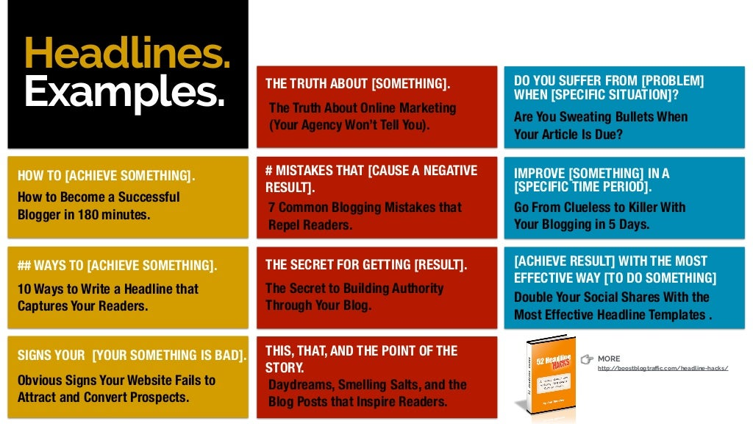
Headlines (CO2)

Slide 33
Imagery (CO2)
Using Images Effectively
Writing for the web is entirely different than writing for print. Oftentimes, people simply don’t have the time, will, or ability to focus on lengthy blog posts without some visual stimulation.
Even a well-formatted blog post consisting solely of text is likely to send your reader screaming back to Twitter within minutes, which is why it’s so important to include images in your posts.

Slide 34
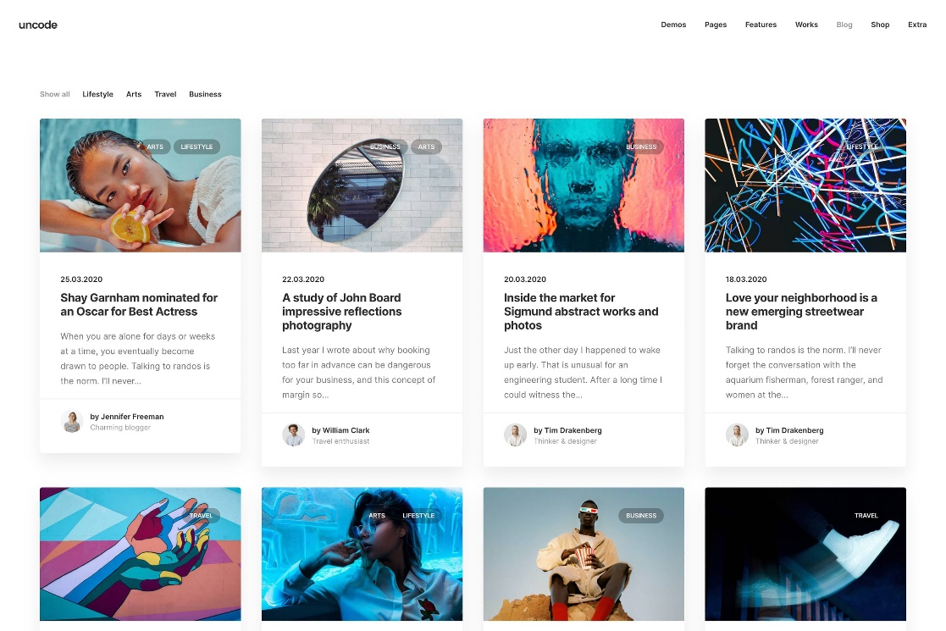


Imagery (CO2)

Slide 35
Imagery (CO2)
Images Help Your Blog Post Flow More Effectively
One of the most important reasons to include images in your blog posts is to break up the text.
Many people scan blog posts rather than pore over every word, and interspersing images throughout the copy will make your post seem less intimidating and more visually appealing.

Slide 36
Recap
Blogging is often described as an online diary or simply as an easy interface to publish content on the web. The internet contains blogs on almost every issue imaginable – in fact, it is estimated that there are currently over 150 million blogs floating around on the Internet!
Many people scan blog posts rather than pore over every word, and interspersing images throughout the copy will make your post seem less intimidating and more visually appealing.

Slide 37
Daily Quiz
_______ is often described as an online diary or simply as an easy interface to publish content on the web.
Creating a blog is always paid. (True/false)
Name any 2 websites where you can do blogging.
Explain the importance of Headlines in a blog.
One of the most important reasons to include _____in your blog posts is to break up the text.

Slide 38
Noida Institute of Engineering and Technology, Greater Noida
(Unit –II) Topic 2
Content Planning & Writing

Slide 39
Objective of Topic /Session
Students will learn about :
Concept of Content Marketing
Content writing

Slide 40
Content Marketing (CO2)
“Content marketing means creating and sharing valuable free content to attract and convert prospects into customers, and customers into repeat buyers.”

Slide 41
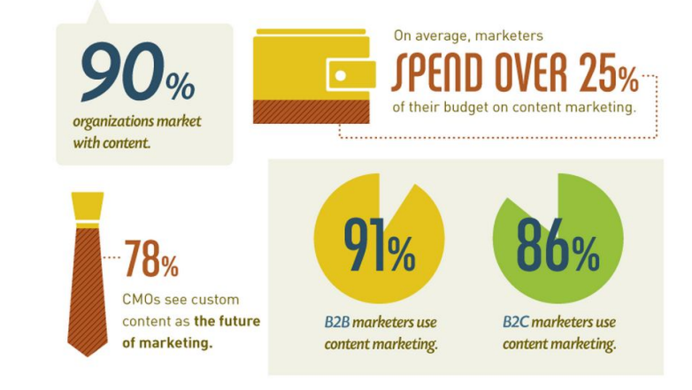
Content Marketing (CO2)

Slide 42
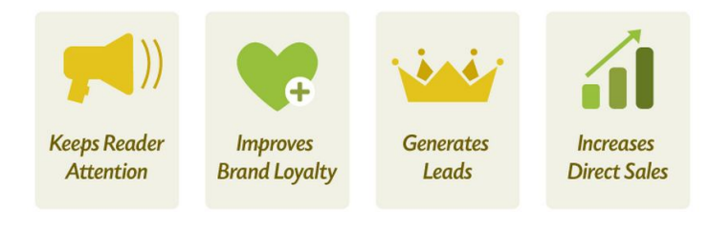
Need of Content Marketing (CO2)

Slide 43
Why Content Marketing? (CO2)
If you don’t create content, no one will find you.
Quality content gets shared
Expert content builds trust
Content generates traffic and leads
Show your audience how your products and services
solve their challenges

Slide 44
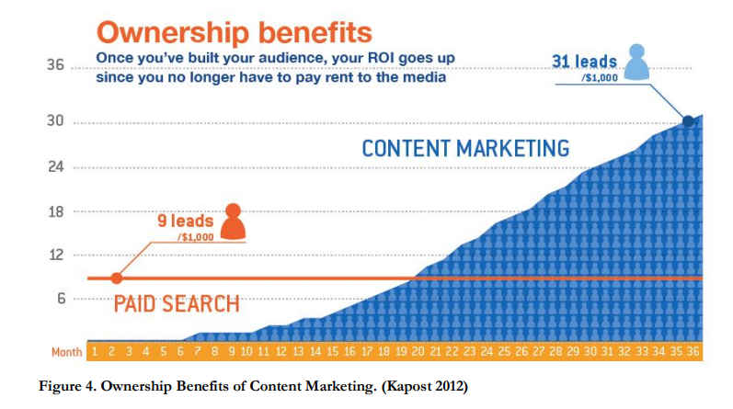
Why Content Marketing? (CO2)

Slide 45
Types of Content Marketing (CO2)
Online Content Marketing
Social Media Content Marketing
Infographic Content Marketing
Blog Content Marketing
Podcast Content Marketing
Video Content Marketing
Paid Ad Content Marketing

Slide 46
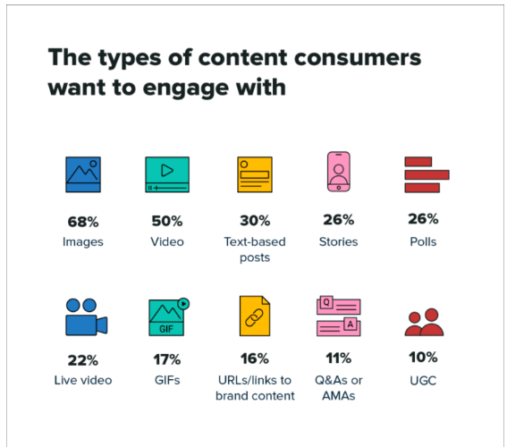
Content Marketing (CO2)

Slide 47
The B.E.S.T. formula & The Four Pillar theory
(CO2)
It companies should not start executing a content marketing campaign before having a sound content strategy. It is possible to apply this formula in most of the media such as online, print and in-person communications.
Behavioral: Everything a business communicates with its customers has a purpose. It is essential to realize the goal of such communications/conversations.
Essential: Deliver information that the target audience needs or useful to their success at work or in life.
Strategic: The content marketing effort must be an integral part of the overall business strategy.
Targeted: The content must be precisely targeted to a specific audience so that it is truly relevant to the buyers.
Notes:
Behavioral • How do we want our customers to feel? • What effect must we achieve with them? • What action do we want them to take? • How will we measure their behaviour? • How will we put them on the path to purchase?
Essential • What do our buyers really need to know? • What will provide them with the most benefit, personally or professionally? • How can we present the content so that it has maximum positive impact? • What are the mandatory elements of the campaign? • What media types must we include?
Strategic • Does this content marketing effort help us achieve our strategic goals? • Does it integrate with our other strategic initiatives?
Targeted • Have we precisely identified the prospects we want to target? • Do we really understand what motivates them? • Do we understand their professional roles? • Do we understand how they view the product or service we offer?

Slide 48
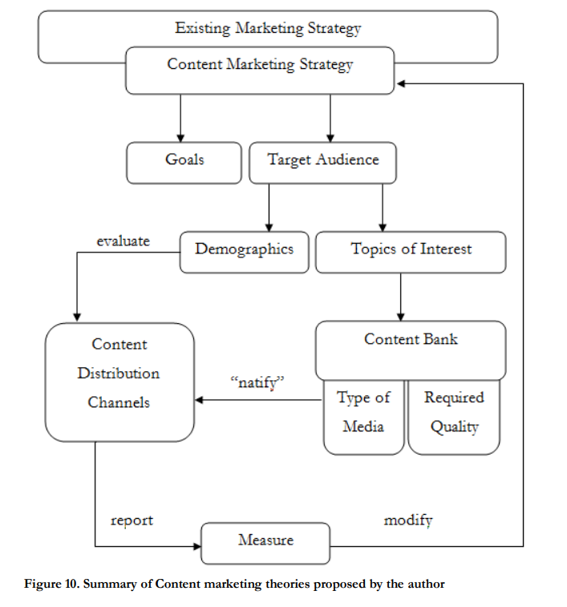
Summary of Content marketing theories
(CO2)
Notes:
Behavioral • How do we want our customers to feel? • What effect must we achieve with them? • What action do we want them to take? • How will we measure their behaviour? • How will we put them on the path to purchase?
Essential • What do our buyers really need to know? • What will provide them with the most benefit, personally or professionally? • How can we present the content so that it has maximum positive impact? • What are the mandatory elements of the campaign? • What media types must we include?
Strategic • Does this content marketing effort help us achieve our strategic goals? • Does it integrate with our other strategic initiatives?
Targeted • Have we precisely identified the prospects we want to target? • Do we really understand what motivates them? • Do we understand their professional roles? • Do we understand how they view the product or service we offer?

Slide 49
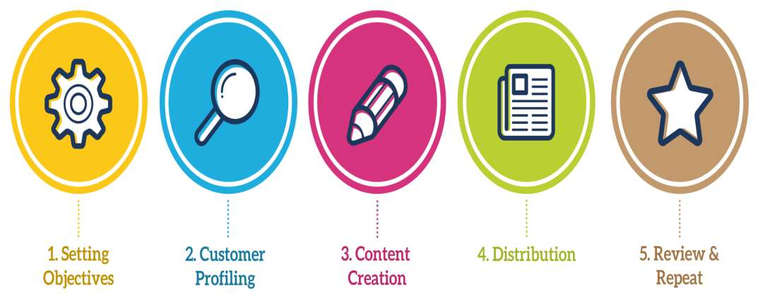
Content Writing Steps (CO2)

Slide 50
Content Writing Objectives (CO2)
1. Make a visitor stay for long
2. Have them visit more than 1 page on your website before leaving
3. Spark Reader Interactions like Comment, Shares, Testimonials, Likes, and Ratings

Slide 51
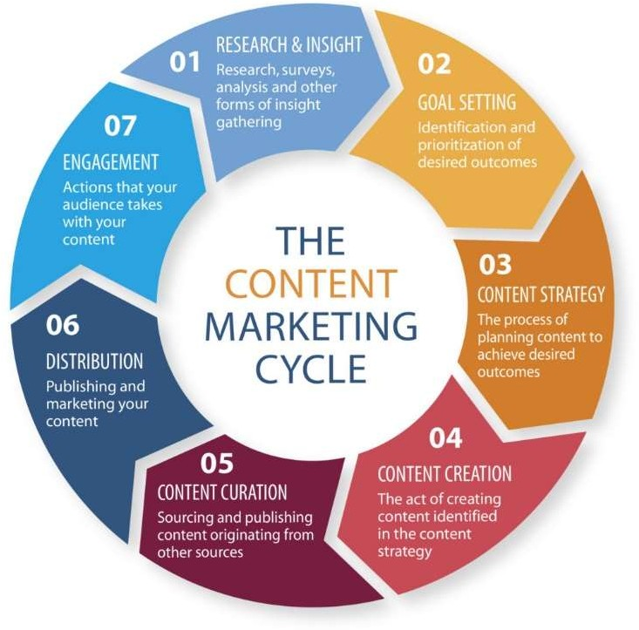
Content Marketing Cycle (CO2)

Slide 52
Content planning and writing(CO2)
You’ve got to find out which method works best for you, but here are the items we believe every content plan should contain:
Delivery date/time: Remember, timing is important for content marketing, and this will help make sure you’re writing to deadline.
Title: You can’t start writing without a title, even if it’s just a working one. This should outline the main premise of the piece.

Slide 53
Content planning and writing(CO2)
Word count: This will determine how much depth and detail the piece will go into.
Quick summary: Just two or three sentences – outlining key points and your conclusion. You can always add an ‘additional ideas’ section if you want some extra room for your ideas.
Sources: Find sources you can use for research and as inspiration for your piece. This will save you time later and might spark some ideas. Just make sure they’re credible!

Slide 54
Content planning(CO2)
Six Tips for Top-Notch Content Planning:
1. Consider your brand’s stance
2. Know your audience
3. Brainstorm lots of ideas
4. Decide which angle you’ll take
5. Set a goal for each piece of content
6. Choose a strong focus keyword

Slide 55
Daily Quiz
1. _________ does not explicitly promote a brand but is intended to stimulate interest in its products or services.
Video marketing
Celebrity marketing
Content Marketing
Native Marketing
2. Content marketing uses pieces of content, such as :
blogs
eBooks
newsletters, and videos
all of these
3. Which is not true about Content Marketing?
It increases brand awareness
It is an educational tool
It is a direct advertisement of a product or brand.
It complements paid media

